Slide 1
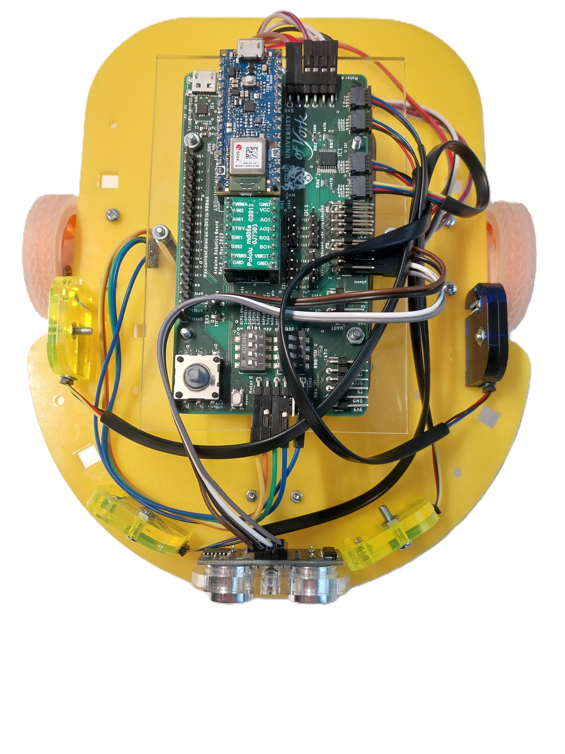
ELE00098H Robotics Design and Construction
AUTONOMOUS MAZE SOLVING ROBOT
BY OSAMA ALSAHLI (fwm509)

Slide 2
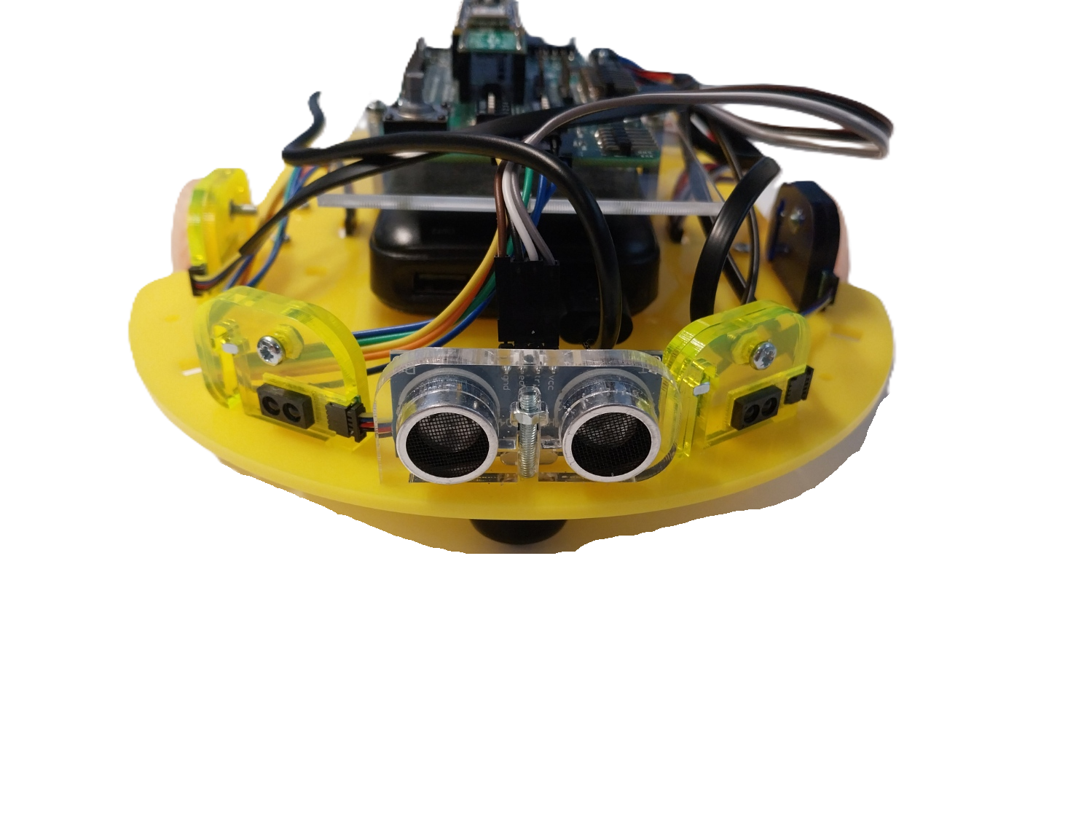
Hardware and Sensor Architecture

Slide 3
Nodes
How does it worked?
Problems:
Stuck in loops
Angled sensors
Blocking motion
Lack separation
Navigation Evolution

Slide 4
Grid
How does it work?
Problems:
T-junction loop.
Friction and wheel slip
Navigation Evolution

Slide 5
Bug-based algorithm
How does it work?
Seek North
Obstacle detected?
Intelligent choice
Resume
Navigation Evolution

Slide 6
Bug-based algorithm
How does it work?
North distance tracking
North distance > 190cm?
yes ⟶ finished
no ⟶ repeat
Navigation Evolution

Slide 7
Bug-based algorithm
How does it work?
Maze finished?
Replay the moves array backwards
Right ⟶ left
Left ⟶ right
Navigation Evolution

Slide 8
Challenges And Solutions

Slide 9
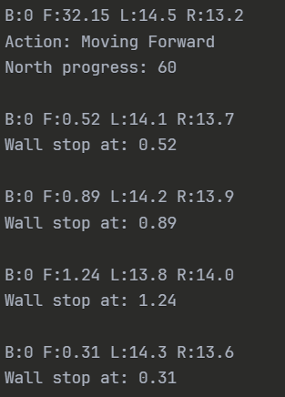
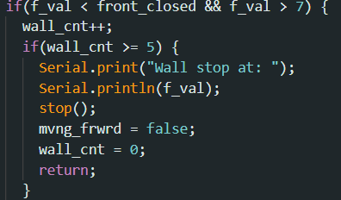
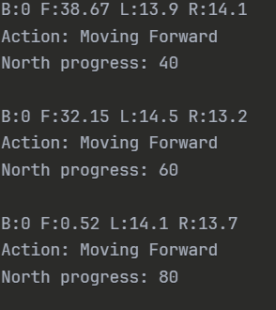
US Sensor noise causing false stops and jittering
3-reading filter before stopping

Slide 10
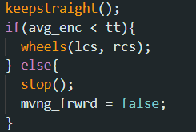
Robot doesn’t stay straight
Implemented encoder count comaparison

Slide 11
Limitations
Does not use shortest path
Finish is detected through
encoders

Slide 12
Navigates unknown mazes.
Detects finish line via distance tracking.
Successfully returns to start using path memory.
Conclusion and Outcomes

Slide 13
Demonstration

